Slide 1





A wearable motor imagery BCI with online feedback
Eng. Antonio Esposito
Ph.D. student in metrology at politecnico di torino

Slide 2
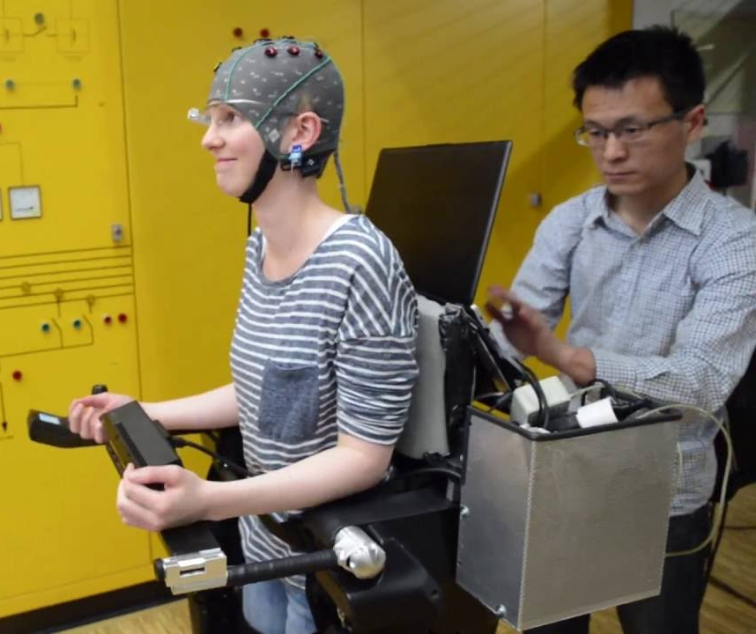
objective and strategy
Being capable to perform motor imagery
rehabilitation
control
Motor imagery can be improved with an online feedback
Compare different feedbacks
visual feedback
haptic feedback
multimodal feedback

Slide 3
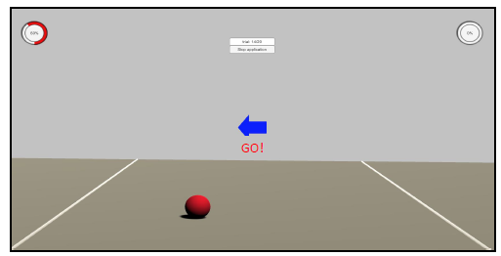
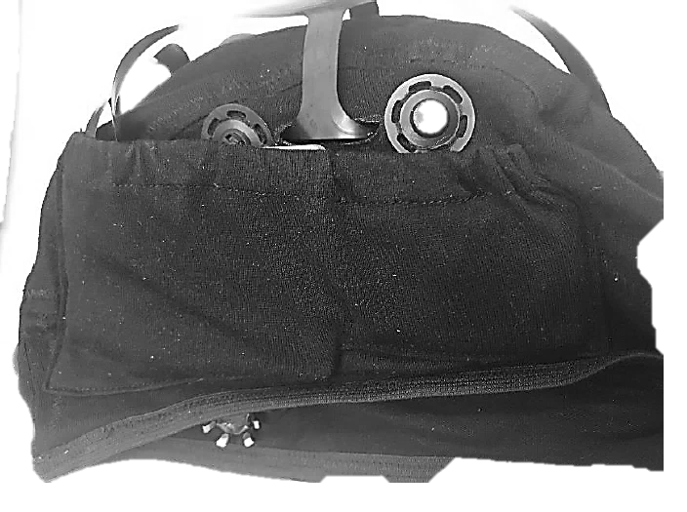
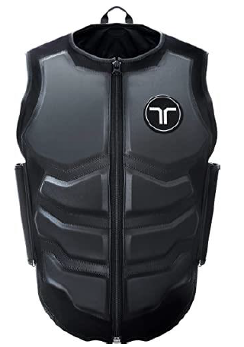

Wearable BCI system
trial indications and visual feedback
EEG acquisition with three bipolar channels with FlexEEG (wet electrodes)
vibrotactile feedback on torso
with haptic suit by bHaptics
Notes:
Wearability is a key novelty

Slide 4


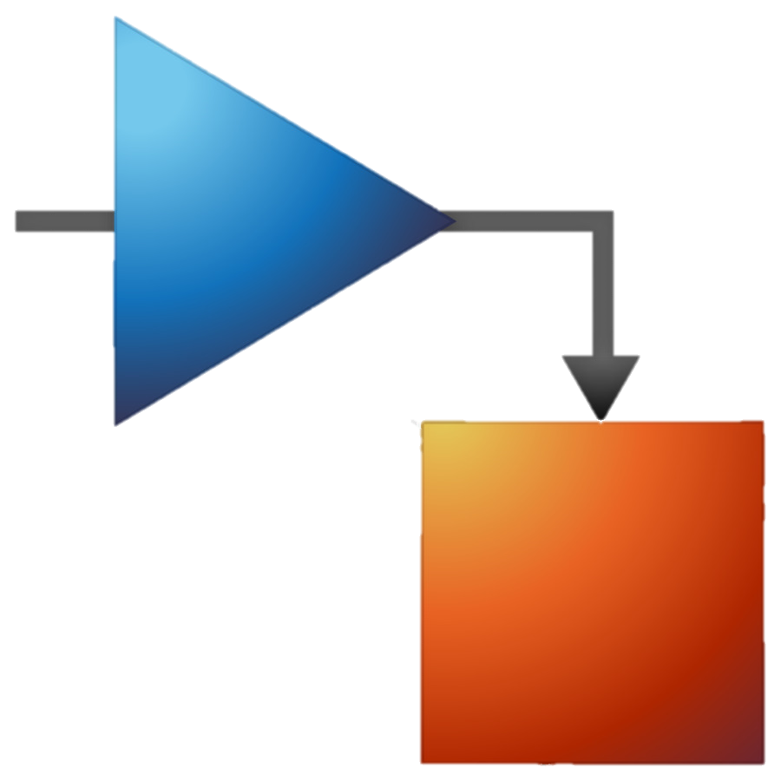
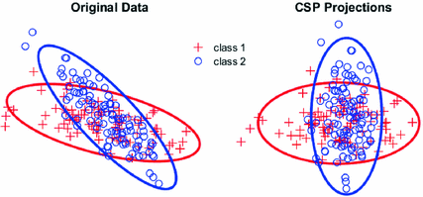


EEG online processing
feedback direction and intensity
UDP
125 Sa/s sampling rate
protocol timing
filter bank
CSP
MIBIF
naïve bayesian
classifier
4-8 Hz
F1
F2
F3
F4
…
Fn
EEG
6-10 Hz
class
info
8-12 Hz
motor imagery class and score
…
36-40 Hz

Slide 5
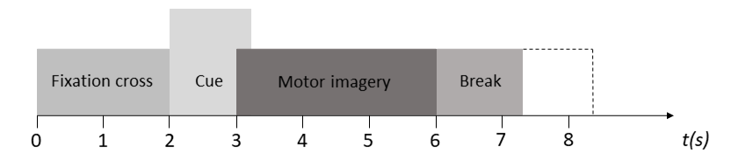
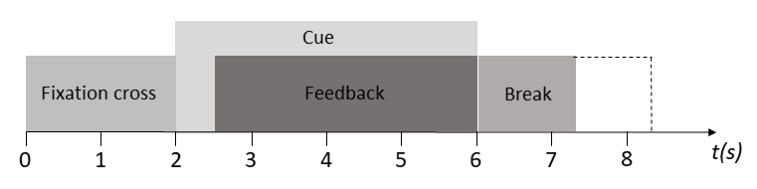

neurofeedback protocol
EEG acquisition without feedback
3 x 30 trials
BLOCK MI
model trained on block MI EEG data
control of feedback intensity
biased feedback (always correct direction)
BLOCK NF
visual: 3 x 30 trials
haptic: 3 x 30 trials
multimodal: 3 x 30 trials

Slide 6
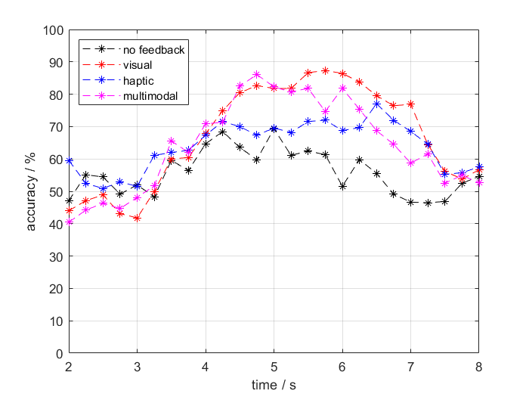
Preliminary results
Moderately trained subject
First session (2 h)
Feedback order was
visual
multimodal
haptic
Visual feedback appears the best, yet it is the more intuitive one
Notes:
Feedback is always better than no feedback

Slide 7

questions?

